Slide 1
Photomicrographs of Plant foods
Broccoli
Permission to reproduce original photomicrographs used to make this collection may be obtained from
Dr. David O. Norris at
david.norris@colorado.edu

Slide 2
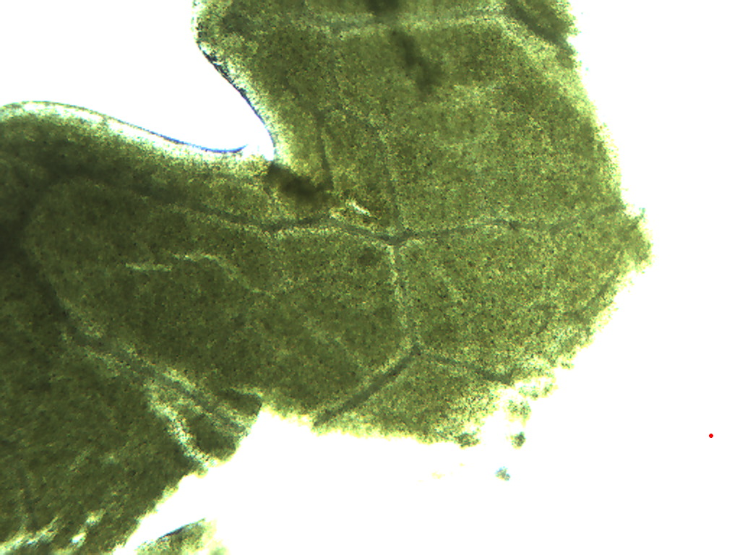
Notes:
99. Braqssica oleacea L., var. botrytis Broccoli. General leaf pattern, 4X. Note veins of vascular tissue (arrows)

Slide 3
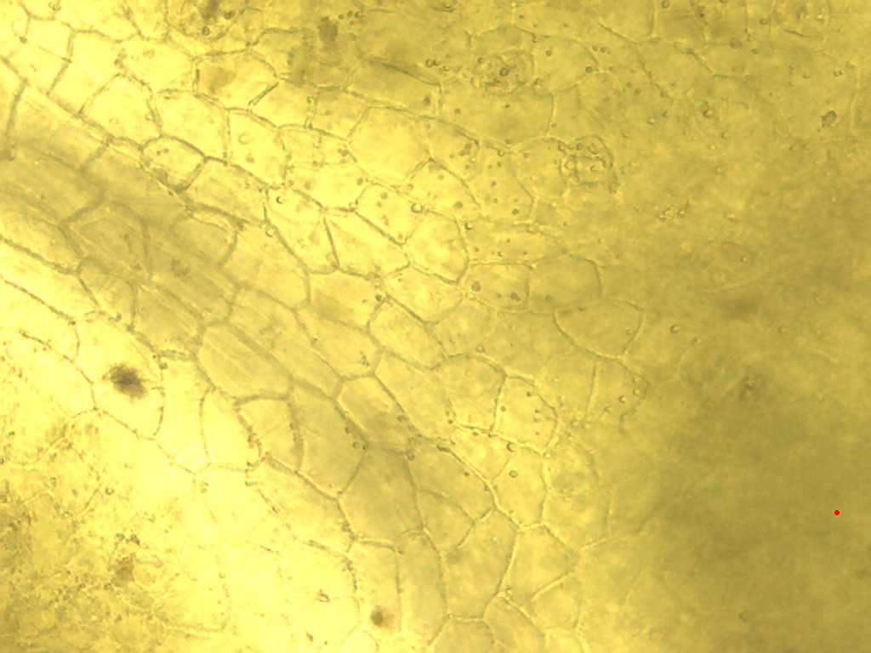
Notes:
100. Broccoli. Leaf unpigmented epidermis, 25X.

Slide 4
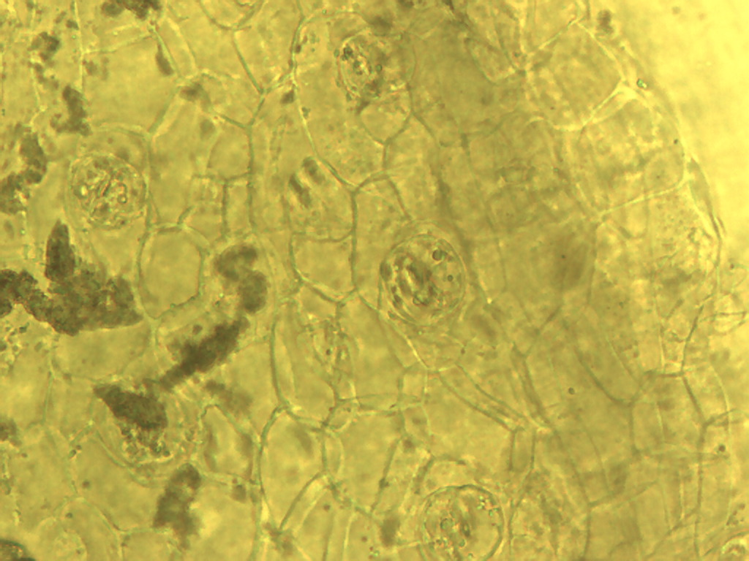
Notes:
101. Broccoli. Leaf stomates in epidermis (arrows), 25X.

Slide 5
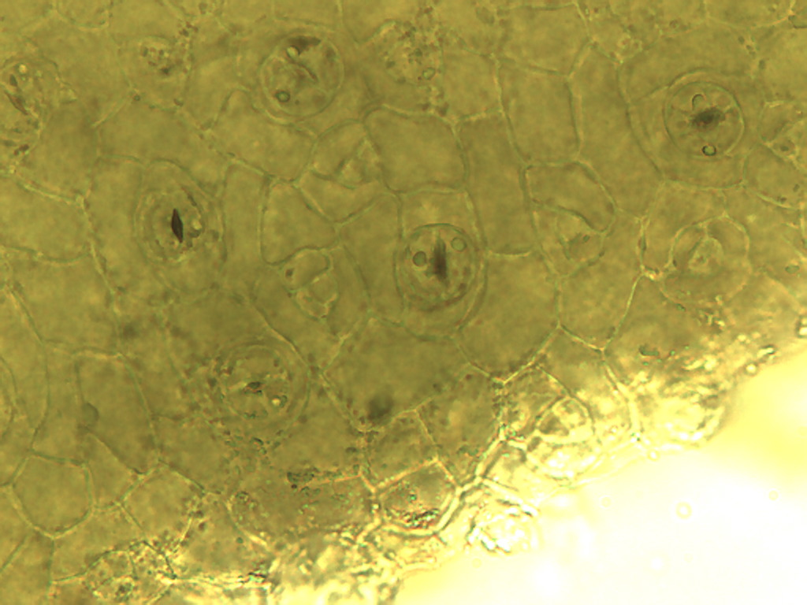
Notes:
102. Broccoli. Leaf epidermal stomates (arrows), 40X.

Slide 6
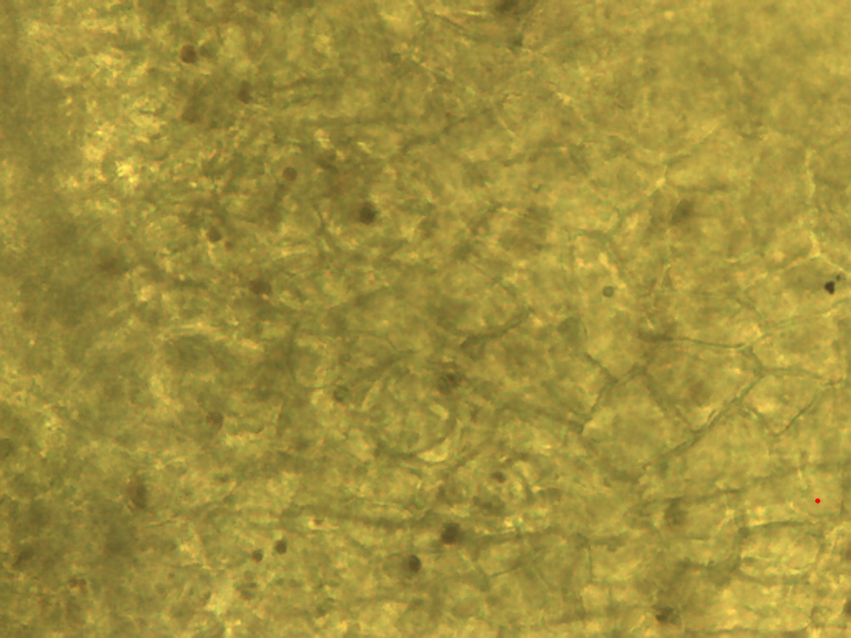
Notes:
103. Broccoli. Leaf surface showing pigment granules (arrows), 40X.

Slide 7
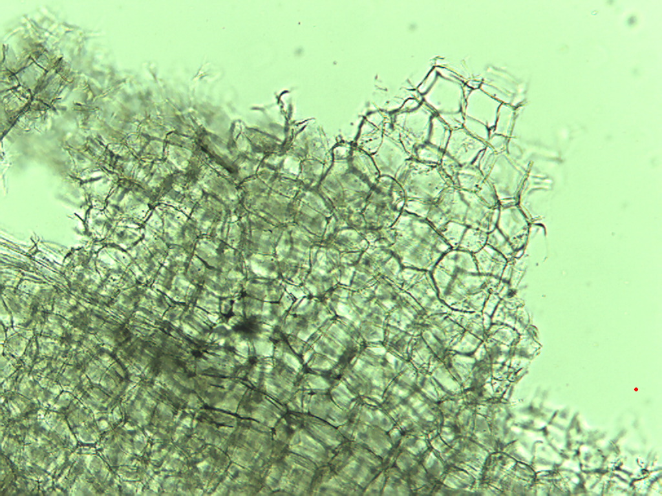
Notes:
104. Broccoli. Stem cells, 10X.

Slide 8
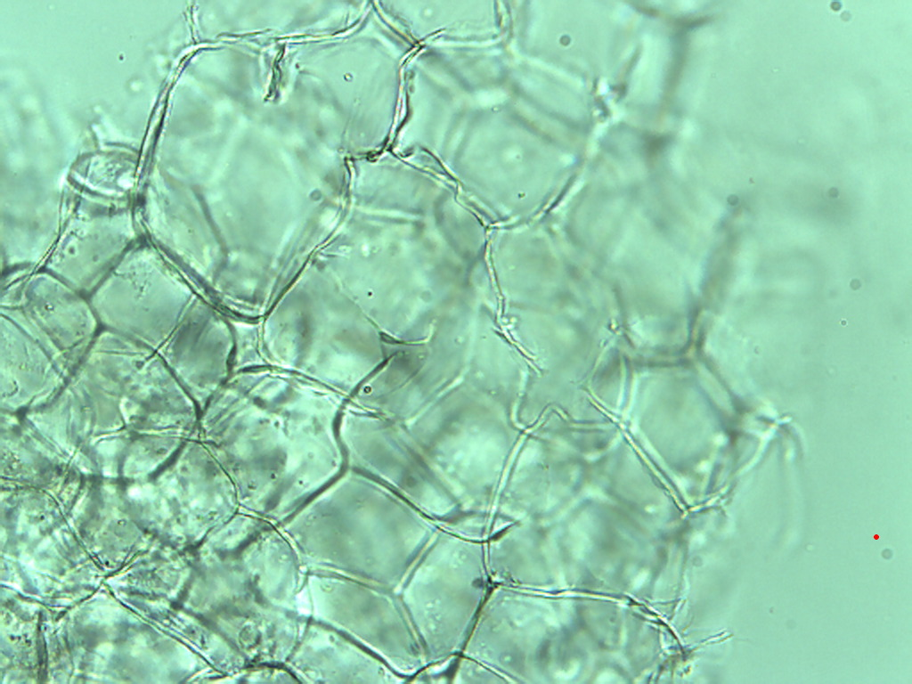
Notes:
105. Broccoli. Stem cells, 25X.

Slide 9
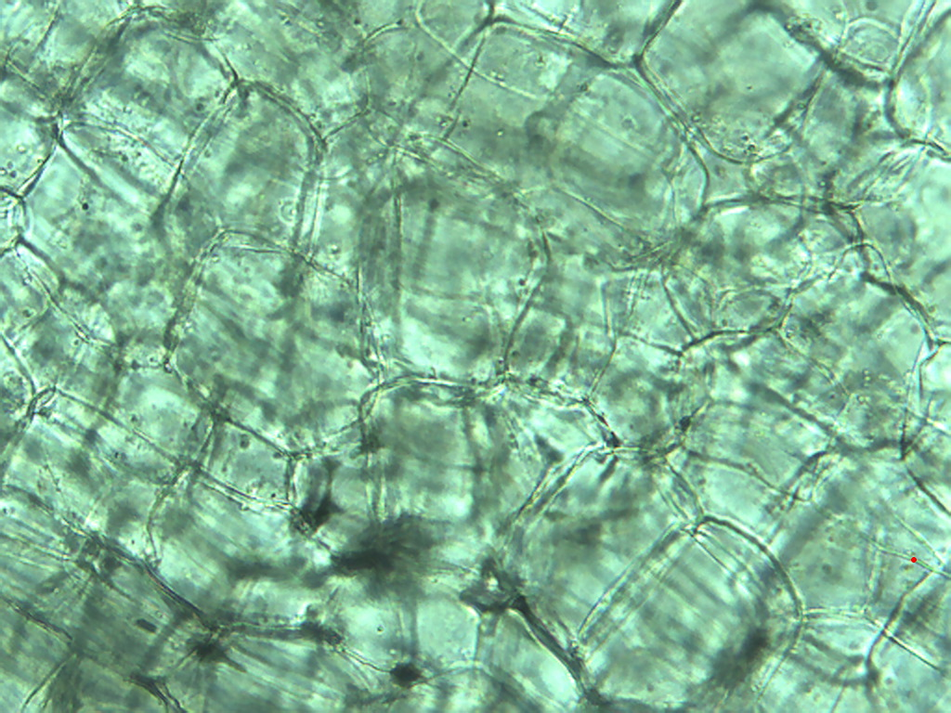
Notes:
106. Broccoli. Stem cells, 25X.

Slide 10
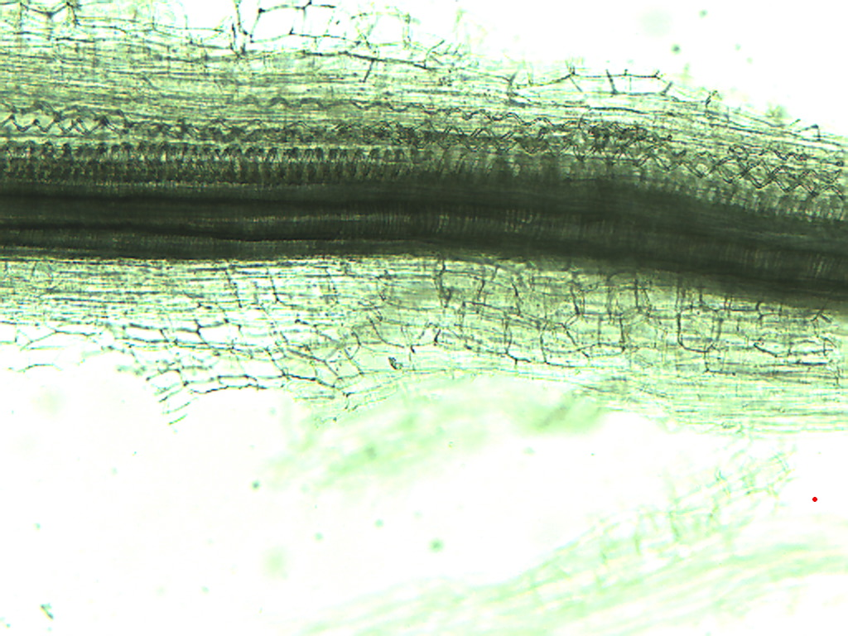
Notes:
107. Broccoli. Stem vascular tissue, 10X.

